Slide 1
Notice and Agreement Endocrine - Lecture #9 – Pathology of the Adrenal Gland I
This session is being recorded
Class recordings are distributed for the exclusive use of students in the LMU DeBusk College of Osteopathic Medicine. Student access to and use of class recordings are conditioned on agreement with the terms and conditions set below. Any student who does not agree to them is prohibited from accessing or making any use of such recordings.
Any student accessing class recordings (1) acknowledges the faculty members’ intellectual property rights in recorded lectures and class materials and that distribution of the recordings violates the DCOM Copyright Policy; (2) recognizes the privacy rights of fellow students who speak in class; (3) accepts that distributing, posting, or uploading class recordings to students or any other third party not authorized to receive them or to those outside DCOM is an Honor Code violation; and (4) agrees that recordings are to be accessed and used only as directed by the faculty member(s) teaching the course.
Notes:
For the course name, lecture # and lecture title, faculty are to use EXACTLY what is listed on the official schedule on the LMU-DCOM website.

Slide 2
Pathology of the Adrenal Gland I
Arshad Ahsanuddin, M.D.
Department of Pathology/Basic Medical Sciences
LMU DCOM-K, Rm. 216
Reading Assignment:

Slide 3
Objectives
Describe the etiologies, clinical features including laboratory interpretation, pathogenesis, and morphology of hyperadrenal syndromes, including Cushing syndrome, hyperaldosteronism, and adrenogenital syndrome.
Compare and contrast the above entities, and be able to formulate a differential diagnosis based on the disease features to arrive at a most likely diagnosis.

Slide 4
Normal Adrenal Gland: Structure and Function
See also: separate review presentation,
Adrenal - Review of Normal

Slide 5
Adrenal glands: Gross Anatomy
Zona Reticularis
Zona Fasciculata
Zona Glomerulosa
Notes:
The paired adrenal, or suprarenal, glands lie on the superior pole of each kidney. Roughly triangular, flattened glands, they are about 7 cm long, 3 cm high, and 1 cm thick, with a combined weight of about 10 g. Each is an organ composed of two distinct parts—cortex and medulla—with separate functions.
The cortex, yellow to the naked eye, makes up 90% of the gland. Its secretory cells produce three classes of steroid hormones. The medulla makes up 10% of the gland and in life is reddish-brown. Its secretory cells are the source of the catecholamines epinephrine and norepinephrine.

Slide 6
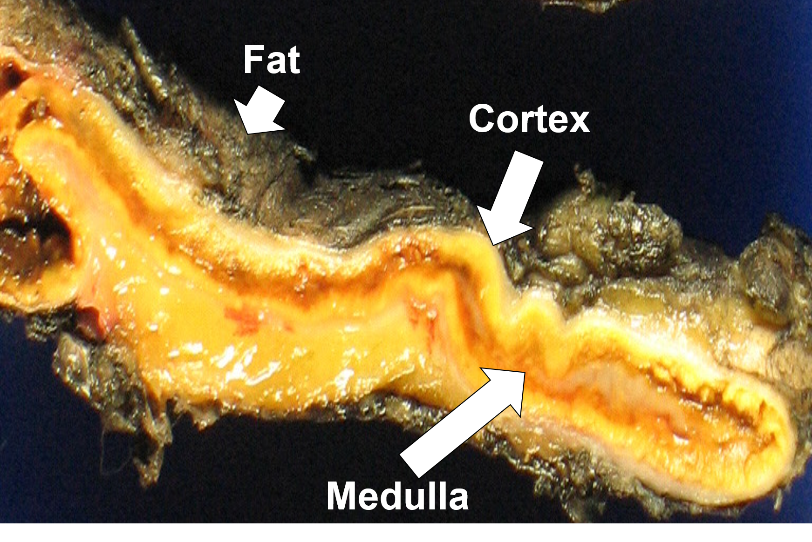
Adrenal Gland – Gross Morphology
Note bright yellow coloration of cortex due to high concentrations of lipid and steroid hormones.
Notes:
Gross morphology of adrenal gland – fresh tissue: bright yellow cortex, tan/grey medulla. Note subtle differences in coloration of cortex that can (almost) visually separate the three layers on gross examination.

Slide 7
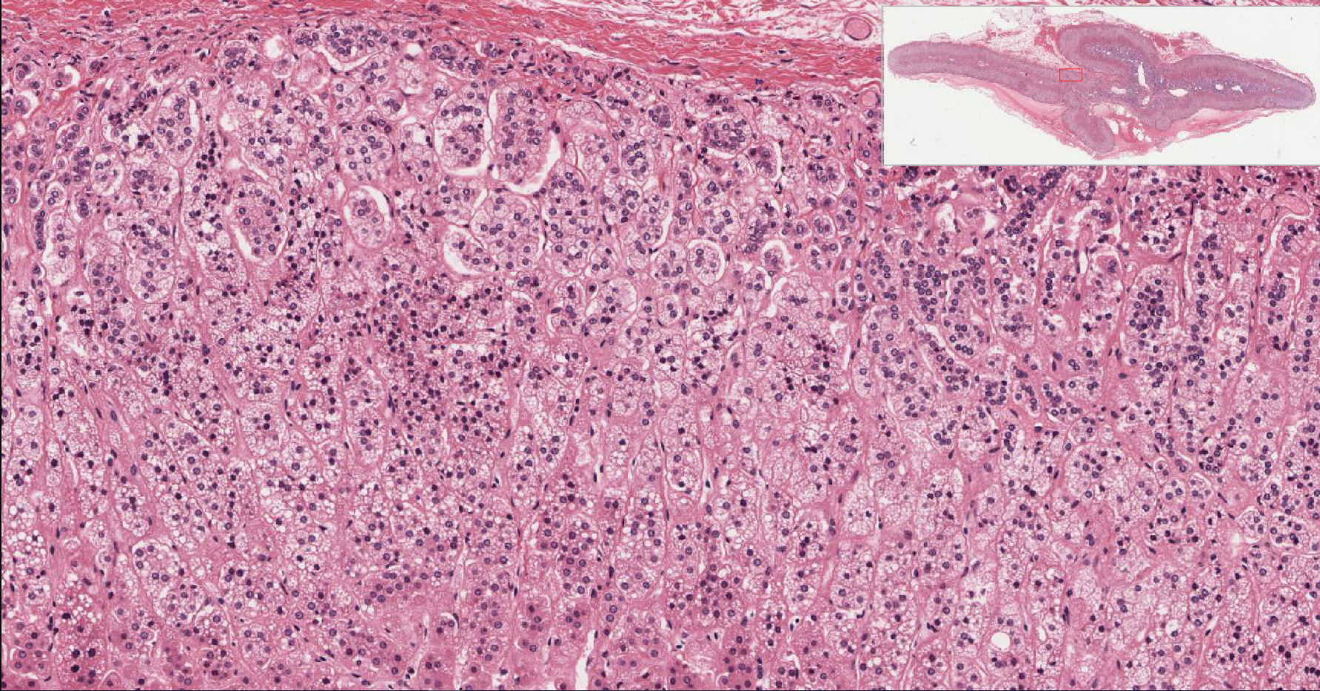
ADRENAL CORTEX
Notes:
Low power histology of the adrenal cortex

Slide 8
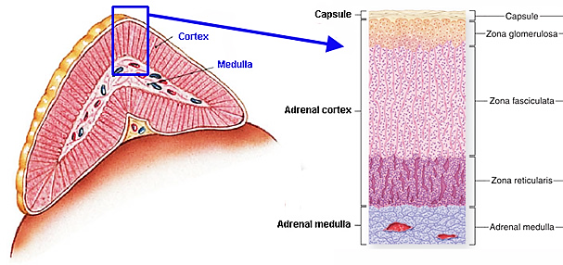
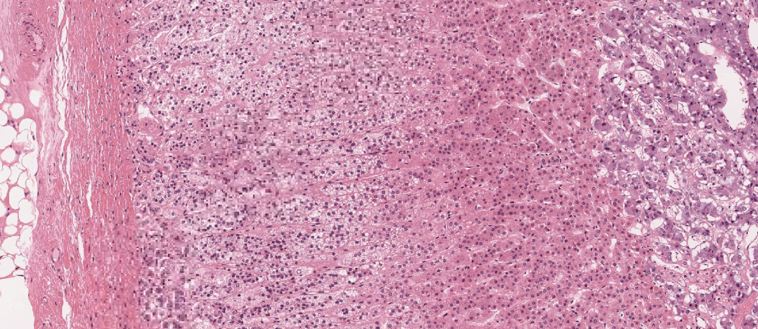
Adrenal gland: Layers
Notes:
The cortex and medulla are enclosed in a common connective tissue capsule.
The adrenal cortex has three zones, which are histologically distinct.
The zona glomerulosa, just under the capsule, represents 10%-15% of the cortex and is made of closely packed, rounded clusters of parenchymal cells that produce mineralocorticoids, mainly aldosterone.
The middle zona fasciculata, forming up to 75% of the cortex, consists mainly of radially oriented cords of polyhedral cells in close relation to sinusoidal fenestrated capillaries. These cells contain many lipid droplets, so they appear washed out and are called spongiocytes. They are the main source of steroid hormones such as cortisol, although to a lesser degree, they also produce androgens.
The thin innermost zona reticularis makes up 5%-10% of the cortex. Its smaller, more acidophilic parenchymal cells are arranged as an anastomosing network of short cords with intervening sinusoidal capillaries. These cells synthesize androgens.

Slide 9
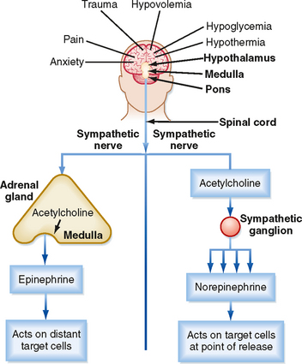
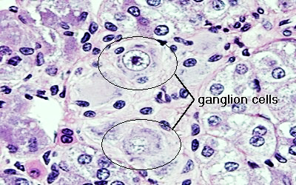
ADRENAL MEDULLA
Notes:
The medulla contains cords or nests of polyhedral chromaffin cells surrounded by fenestrated capillaries. Developmentally, they are modified postganglionic sympathetic neurons that produce two classes of catecholamines. In humans, the same chromaffin cell typically includes both hormones (epinephrine and norepinephrine).
Preganglionic sympathetic neurons regulate their secretion.

Slide 10
Questions?

Slide 11
Functional Adrenal Cortex Pathology
Hormone excess syndromes:
Glucocorticoid excess – Cushing syndrome
Mineralocorticoid excess – Hyperaldosteronism
Sex hormone excess – Adrenogenital syndrome
Hormone Deficiency Syndromes (next lecture):
Primary Adrenocortical Insufficiency
Secondary Adrenocortical Insufficiency

Slide 12
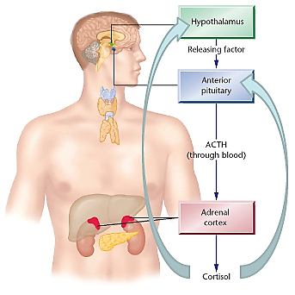
Glucocorticoid Excess: Cushing Syndrome
Clinical Features of Cushing Syndrome
Truncal obesity, moon facies, buffalo hump (fat deposits in the posterior neck and back)
Hypertension
Muscle weakness (proximal) and decreased muscle mass (selective atrophy of fast-twitch fibers)
Secondary diabetes due to gluconeogenesis and inhibited uptake of glucose by cells
Skin is fragile, thin and bruises easily due to loss of collagen (catabolic effects); also, skin striae (especially abdomen) and poor wound healing occur
Osteopenia due to catabolic resorption of bone
Increased susceptibility to infections
Mental disorders
Hirsutism
Menstrual abnormalities
In children, decreased linear growth
Notes:
Cushing syndrome occurs when your body has too much of the hormone cortisol over time. Excess cortisol causes some of the hallmark signs of Cushing syndrome — a fatty hump between your shoulders, a rounded face, and pink or purple stretch marks on your skin. Cushing syndrome can also result in high blood pressure, bone loss and, on occasion, type 2 diabetes.

Slide 13
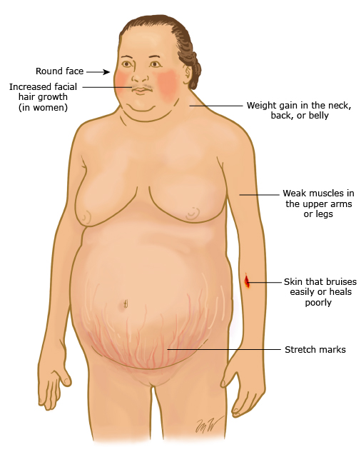
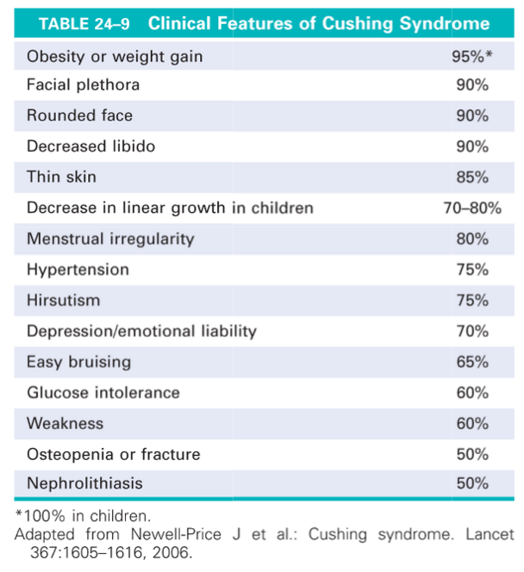
Notes:
Common signs and symptoms of Cushing syndrome
Weight gain and fatty tissue deposits, particularly around the midsection and upper back, in the face (moon face), and between the shoulders (buffalo hump)
Pink or purple stretch marks (striae) on the skin of the abdomen, thighs, breasts and arms
Thinning, fragile skin that bruises easily
Slow healing of cuts, insect bites and infections
Acne
Signs and symptoms women with Cushing syndrome may experience
Thicker or more visible body and facial hair (hirsutism)
Irregular or absent menstrual periods
Signs and symptoms men with Cushing syndrome may experience
Decreased sex drive
Decreased fertility
Erectile dysfunction

Slide 14
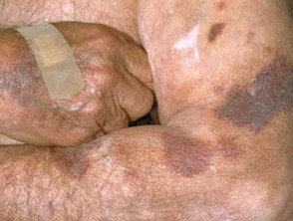
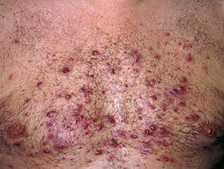
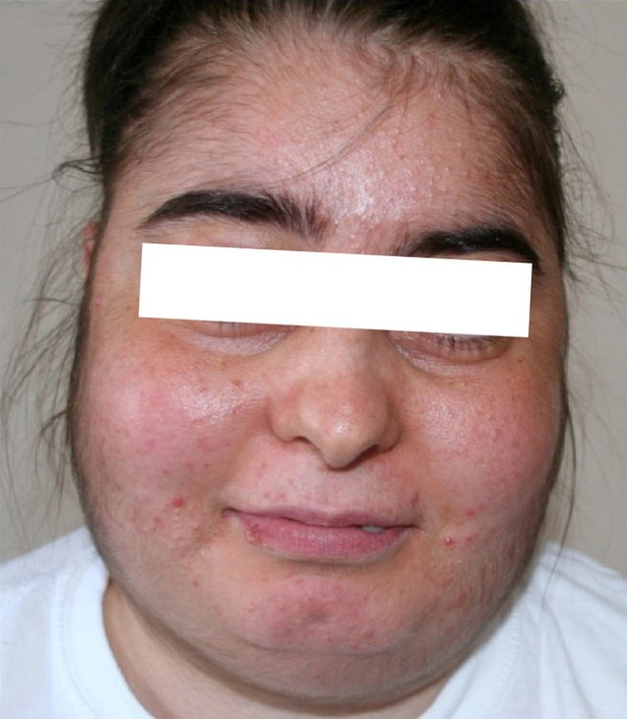
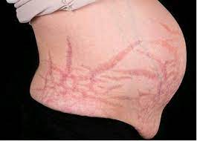
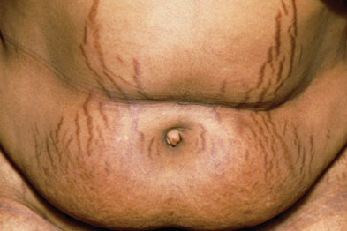
Steroid Acne
Round “moon” facies
Round “moon” facies
Skin atrophy/fragility (bruisability)
Purple Striae (stretch marks)
Purple Striae (stretch marks)
Cushing Syndrome: Skin Changes

Slide 15
Causes of Cushing Syndrome 1
Exogenous: Most cases of Cushing syndrome are iatrogenic, due to administration of corticosteroids. Rarely, factitious cases arise, due to illicit administration of exogenous glucocorticoids.
Endogenous:
ACTH-Dependent
Cushing Disease: ACTH-secreting pituitary adenomas
65-70% of cases of endogenous hypercorticolism
usually females, microadenomas (90-95%)
Ectopic ACTH syndrome
10-15% of cases, usually from non-pituitary ACTH-secreting tumor
small cell carcinoma of lung and other neuroendocrine neoplasms
Usually lacks feedback inhibition by exogenous dexamethasone therapy
Ectopic CRH (corticotropin releasing hormone) syndrome
<1% of cases, usually from non-pituitary CRH-secreting tumor (e.g. hypothalamic)
May be responsive to feedback inhibition by exogenous dexamethasone or cortisol (only if doesn’t also secrete ACTH)
Causes bilateral diffuse pituitary hyperplasia
Iatrogenic or factitious Cushing's syndrome due to administration of exogenous ACTH (not glucocorticoids)
Notes:
Exogenous: Cushing syndrome can develop from taking oral corticosteroid medications, such as prednisone, in high doses over time. It's also possible to develop Cushing syndrome from injectable corticosteroids — for example, repeated injections for joint pain, bursitis and back pain. Inhaled steroid medicines for asthma and steroid skin creams used for skin disorders such as eczema are generally less likely to cause Cushing syndrome than are oral corticosteroids.
Endogenous: can be due to your body producing either too much cortisol or too much adrenocorticotropic hormone (ACTH), which regulates cortisol production.
A pituitary gland tumor (pituitary adenoma). Cushing disease. It occurs much more often in women and is the most common form of endogenous Cushing syndrome.
An ACTH-secreting tumor. Rarely, a tumor that develops in an organ that normally doesn't produce ACTH will begin to secrete this hormone in excess. These tumors, which can be noncancerous (benign) or cancerous (malignant), are usually found in the lungs, pancreas, thyroid or thymus gland.

Slide 16
Causes of Cushing Syndrome 2
Endogenous (cont.)
ACTH-Independent:
Primary adrenocortical neoplasms – 18 to 20% (see Adrenal II lecture)
aka primary adrenocortical hyperfunction
May be benign or malignant
Suppress ACTH and CRH by negative feedback inhibition
Associated with atrophy of pituitary corticotrophs and adrenal zona fasciculata/zona reticularis
Bilateral micronodular adrenal hyperplasia - <1% of cases
aka primary pigmented nodular adrenocortical disease (PPNAD)
May be familial (Carney Syndrome, autosomal dominant) or sporadic
Bilateral macronodular adrenal hyperplasia (BMAH) - <1% of cases
associated with adrenal glands that weigh up to 500 g or more, and contain multiple nonpigmented nodules >5 mm in diameter.
Other rare disorders
Notes:
Primary adrenal gland cortical neoplasm. Disorders of the adrenal glands can cause them to produce too much cortisol. The most common is a noncancerous tumor of the adrenal cortex, called an adrenal adenoma, but only a small fraction of adenomas produce too much cortisol. Cancerous tumors of the adrenal cortex are rare, but they can cause Cushing syndrome as well.
Benign, nodular enlargement of both adrenal glands can result in Cushing syndrome.
Familial Cushing syndrome. Rarely, people inherit a tendency to develop tumors on one or more of their endocrine glands, affecting cortisol levels and causing Cushing syndrome.

Slide 17
Which patients should be tested?
No evidence of exogenous glucocorticoid activity – may be iatrogenic (including inhaled steroids) or factitious (rare)
Unusual findings for age (osteoporosis or hypertension in young adults)
Multiple progressive features of Cushing syndrome (CS), particularly those that are predictive of CS such as facial plethora, proximal myopathy, striae (>1 cm wide and red/purple), and easy bruising
Unexplained severe features of CS at any age (e.g. resistant hypertension, osteoporosis)
Incidental adrenal adenomas
Notes:
Rule out exogenous glucocorticoid administration
Unusual findings for age (osteoporosis or hypertension in young adults)
Multiple progressive features of Cushing syndrome (CS), particularly those that are predictive of CS such as facial plethora, proximal myopathy, striae (>1 cm wide and red/purple), and easy bruising
Unexplained severe features of CS at any age (e.g. resistant hypertension, osteoporosis)
Incidentally-discovered adrenal adenomas

Slide 18
Screening tests for Cushing syndrome
First-line tests:
late-night salivary cortisol (two measurements)
24-hour urinary free cortisol (UFC) excretion (two measurements)
overnight 1 mg dexamethasone suppression test (DST)
For patients with a low index of suspicion, we suggest initial testing with one first line test
For patients with a high index of suspicion, such as those with features suggestive of CS, two or three first-line tests are suggested (with repeated measurement for UFC or salivary cortisol)
Any abnormal result:
in patients with at least one abnormal test result, refer to Endocrinology for more specific testing
Exclude physiologic hypercortisolism that might mimic CS
Notes:
First-line screening tests (high sensitivity/low specificity):
late-night salivary cortisol (two measurements)
24-hour urinary free cortisol (UFC) excretion (two measurements)
overnight 1 mg (high-dose) dexamethasone suppression test (DST)
Any abnormal result:
in patients with at least one abnormal test result, refer to Endocrinology for more specific testing
Exclude physiologic hypercortisolism that might mimic CS

Slide 19
Testing strategies to define etiology of Cushing syndrome
ACTH levels
Dexamethasone suppression test
Abnormal pituitary ACTH production (e.g. pituitary adenoma)
High ACTH level
cortisol levels NOT suppressed by LOW dose dexamethasone BUT can be suppressed by HIGH dose dexamethasone (feedback inhibition of pituitary)
Ectopic ACTH secretion
High ACTH level – outside of HPA Axis (no feedback inhibition)
cortisol levels are NOT suppressed by low or high dose dexamethasone
Adrenal tumor or nodular hyperplasia
Low ACTH level due to feedback inhibition of pituitary ACTH secretion by cortisol produced autonomously by the tumor or nodular hyperplasia
cortisol levels are NOT suppressed by low or high doses of dexamethasone
Notes:
Testing strategies to define etiology of Cushing syndrome
ACTH levels
High and low dose Dexamethasone suppression test

Slide 20
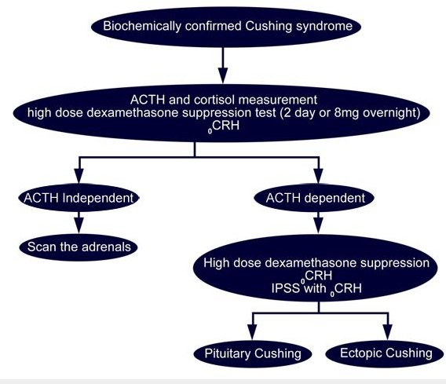
Testing to determine etiology of Cushing syndrome
ACTH-independent
ACTH low
Cortisol high
Cortisol production will not be suppressed by high dose dexamethasone
CRH stimulation (corticotropin releasing hormone) will not further increase high baseline cortisol level and low baseline ACTH
Hypercortisolism is present
ACTH-dependent
ACTH elevated
Cortisol elevated
IPSS: inferior petrosal sinus sampling with CRH stimulation may better clarify if ACTH is ectopic or pituitary
Ectopic ACTH production
high dose dexamethasone does not suppress elevated ACTH and cortisol levels
CRH stimulation does NOT further increase baseline high levels of ACTH or cortisol
Pituitary adenoma
high dose dexamethasone suppresses elevated ACTH and cortisol levels
CRH stimulation will increase ACTH and cortisol to even higher levels if a corticotropin pituitary adenoma is present

Slide 21
Bilateral macronodular adrenal hyperplasia (BMAH)
RARE, less than 100 cases - multiple, yellow nodules, >1 cm
Usually sporadic in adults (mean age 45-55)
Some reports of autosomal dominant familial cases – associated with germline mutation in armadillo repeat containing 5 (ARMC5) gene, putative tumor suppressor gene
Production of cortisol induced by non-ACTH hormones due to expression of activating receptors on the adrenal cortex, e.g. vasopressin (ADH), serotonin, LH, etc.)
McCune-Albright syndrome: subset of macronodular hyperplasia
sporadic gain of function mutation of G_{s}α gene* (GNAS) during development
Triad of polyostotic fibrous dysplasia of bone, café au lait spots, autonomous endocrine hyperfunction (may be associated with precocious puberty)
* FYI: G_{s}α = GUANINE NUCLEOTIDE-BINDING PROTEIN, ALPHA-STIMULATING ACTIVITY POLYPEPTIDE 1
Notes:
BMAH: RARE, less than 100 cases - multiple nodules, >1 cm
Usually sporadic in adults (mean age 45-55)
Associated with germline ARMC5 mutations
McCune-Albright syndrome: subset of macronodular hyperplasia
sporadic gain of function mutation of G_{s}α gene* (GNAS) during development
Triad of polyostotic fibrous dysplasia of bone, café au lait spots, autonomous endocrine hyperfunction (may be associated with precocious puberty)

Slide 22
Primary pigmented nodular adrenal disease (PPNAD)
Aka bilateral micronodular adrenal hyperplasia, ‘black adenoma’: multiple pigmented nodules, <1 cm
Associated with a paradoxical increase in serum cortisol levels in response to a dexamethasone challenge
May be sporadic (30%) or familial (70%): autosomal dominant, mostly PKRAR1A mutations (cAMP-dependent protein kinase PKA type I-A regulatory subunit)
Associated with Carney complex in 50% of cases (very rare, ~750 cases reported):
Characteristic distribution of pigmented skin lesions: lentigo (lips, conjunctiva, inner and outer canthi, and vaginal/penile mucosa), café au lait spots, and epithelioid blue nevi (rare in general population)
Multiple endocrine abnormalities, including pituitary somatotroph hyperplasia, growth hormone secreting pituitary adenomas, thyroid adenomas and carcinomas
Other tumors:
Myxomas of skin, mucosa, heart and sometimes breast
Psammomatous melanotic schwannomas
large-cell calcifying Sertoli cell tumours of the testes
breast ductal adenoma and myxoid fibroadenomas
osteochrondomyxomas of the bone
Notes:
Aka bilateral micronodular adrenal hyperplasia, ‘black adenoma’: multiple pigmented nodules, <1 cm
Associated with a paradoxical increase in serum cortisol levels in response to a dexamethasone challenge
May be sporadic (30%) or familial (70%): autosomal dominant, mostly PKRAR1A mutations (cAMP-dependent protein kinase PKA type I-A regulatory subunit)
Associated with Carney complex (very rare, ~750 cases reported):

Slide 23
Morphology – Cushing Syndrome
Morphologic tissue changes depend on etiology:
Adrenal cortical atrophy in exogenous corticosteroid administration, due to suppression of ACTH
Diffuse hyperplasia – ACTH-dependent Cushing syndrome
Gross – Both glands enlarged, weighing up to 30 grams with diffusely thickened and variably nodular cortex
Microscopic – Expanded “lipid-poor” zona reticularis with compact, eosinophilic cells, surrounded by an outer zone of vacuolated “lipid-rich” cells (any nodules are “lipid-rich”)
Nodular hyperplasia – ACTH-independent; rare
Macronodular - adrenals almost entirely replaced by nodules of varying sizes (≤3 cm with mixture of lipid-poor and lipid-rich cells) with areas between nodules having microscopic nodularity, enlargement up to 500 grams
Micronodular – 1 – 3 mm nodules, pigmented (brown to black, likely lipofuscin) with atrophic intervening areas
Neoplasia – ACTH-independent
Notes:
Morphologic tissue changes depend on etiology:
Adrenal cortical atrophy in exogenous corticosteroid administration, due to suppression of ACTH
Diffuse hyperplasia – ACTH-dependent
Bilateral Nodular Hyperplasia – ACTH-independent; rare
Macronodular - adrenals almost entirely replaced by nodules of varying sizes (≤3 cm with mixture of lipid-poor and lipid-rich cells) with areas between nodules having microscopic nodularity, enlargement up to 500 grams
Micronodular - 1–3 mm nodules, pigmented (brown to black, likely lipofuscin) with atrophic intervening areas
Neoplasm (benign or malignant) – ACTH-independent

Slide 24
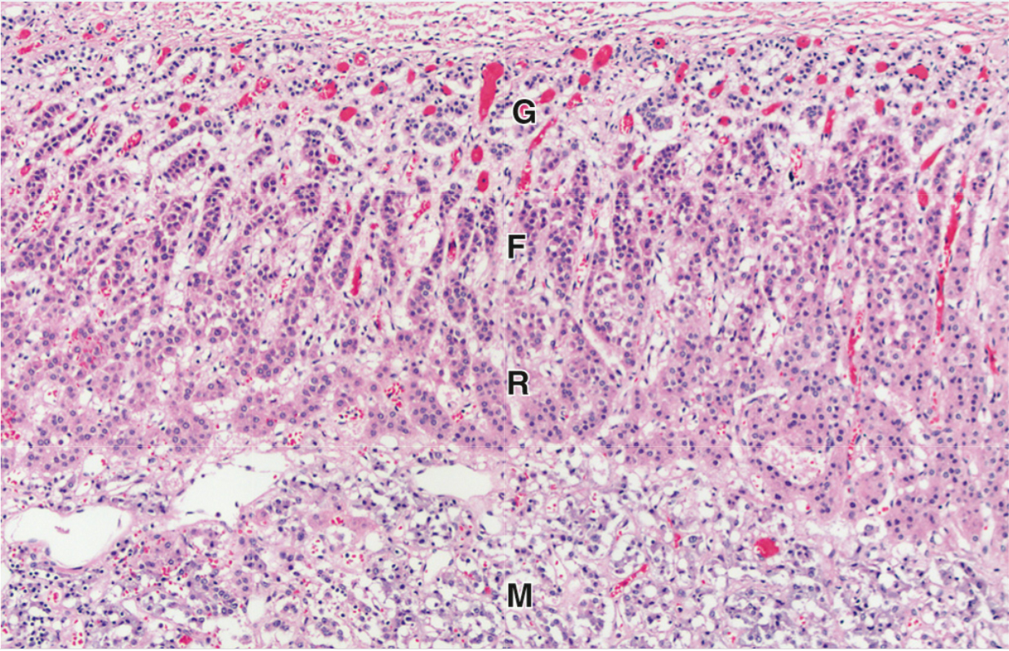
adrenal cortical atrophy
ZF: Lipid depletion
Cushing Syndrome
Adrenal medulla unaffected
Notes:
Adrenal cortical atrophy – note suppression of steroid hormone production (lipid vacuoles) in zone fasciculata

Slide 25
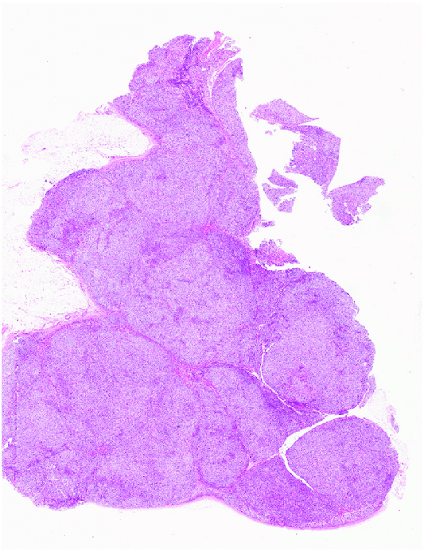
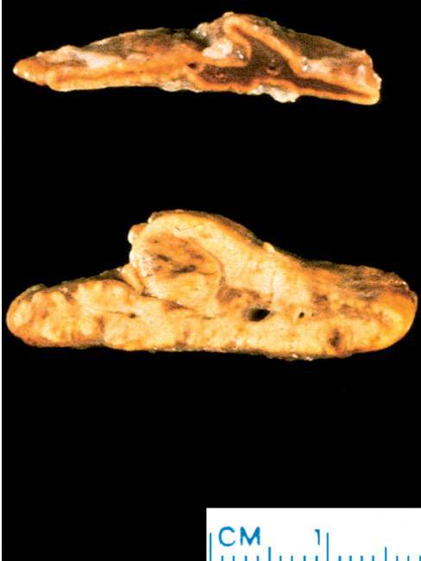
Primary bilateral macronodular adrenocortical hyperplasia
Normal
Hyperplastic
Grossly, the adrenal glands exhibit a lobulated or bosselated appearance due to multiple, irregular, yellow nodules, each greater than 1.0 cm in size
Diffuse adrenal cortical hyperplasia
Notes:
Diffuse hyperplasia – ACTH-dependent Cushing syndrome
Gross – Both glands enlarged, weighing up to 30 grams with diffusely thickened and variably nodular cortex
Macronodular Hyperplasia - adrenals almost entirely replaced by nodules of varying sizes (≤3 cm with mixture of lipid-poor and lipid-rich cells) with areas between nodules having microscopic nodularity, enlargement up to 500 grams
Top left: normal
Bottom left: Diffuse adrenal cortical hyperplasia due to excess ACTH
Right: Primary bilateral macronodular adrenocortical hyperplasia. This disease presents with variable degree of bilateral adrenal enlargement. Grossly, the adrenal glands exhibit a lobulated or bosselated appearance due to multiple irregular yellow nodules, each greater than 1.0 cm in size. This photomicrograph illustrates the multiple unencapsulated and irregular cortical nodular proliferations, composed of lipid-rich clear cells.

Slide 26
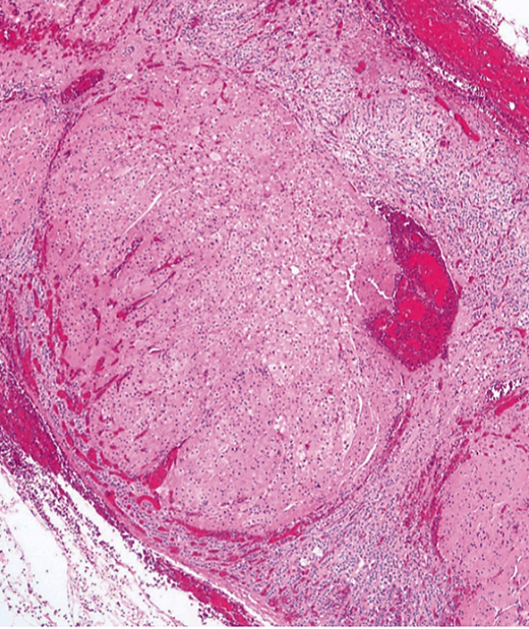
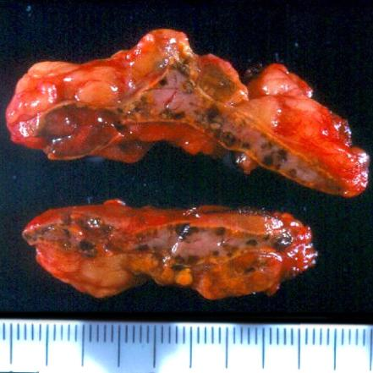
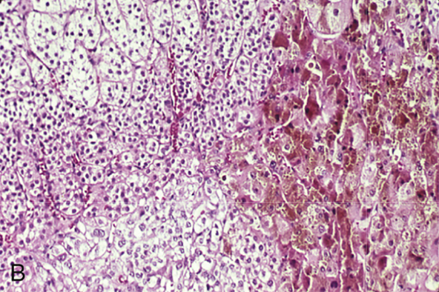
Primary pigmented micronodular disease
Pigmented nodules
< 1 cm
Notes:
Micronodular – 1 – 3 mm nodules, pigmented (brown to black, likely lipofuscin) with atrophic intervening areas

Slide 27
Questions?

Slide 28
Functional Adrenal Cortex Pathology (cont)
Hormone excess syndromes:
Glucocorticoid excess – Cushing syndrome
Mineralocorticoid excess – Hyperaldosteronism
Sex hormone excess – Adrenogenital syndrome
Hormone Deficiency Syndromes (next lecture):
Primary Adrenocortical Insufficiency
Secondary Adrenocortical Insufficiency

Slide 29
Hyperaldosteronism
An excess of aldosterone secretion → HYPERTENSION
May have associated hypokalemia (9-37% of cases)
Primary (non-suppressible) hyperaldosteronism (PHA)
Autonomous overproduction of aldosterone leading to suppression of the renin-angiotensin system
Screening test: plasma aldosterone concentration:plasma renin activity (or concentration) ratio (PAC/PRA or PAC/PRC) → abnormal in 5-10% of hypertension cases
results may suggest either primary aldosteronism (high PAC, low PRA/PRC), secondary hyperaldosteronism (high PAC and nonsuppressed high PRA/PRC), or non-aldosterone mineralocorticoid excess (low PAC, low PRA/PRC).
Most frequent causes of primary hyperaldosteronism:
Bilateral idiopathic hyperaldosteronism
Aldosterone-producing adrenal cortical adenoma
Familial hyperaldosteronism (uncommon)
Secondary (suppressible) hyperaldosteronism
due to extra-adrenal cause due to activation of the renin-angiotension system with elevated plasma levels of renin (e.g. renal hypoperfusion)
Notes:
An excess of aldosterone secretion → HYPERTENSION
May have associated hypokalemia (9-37% of cases)
Primary (non-suppressible) hyperaldosteronism (PHA): (high PAC, low PRA/PRC),
Autonomous overproduction of aldosterone leading to suppression of the renin-angiotensin system
Most frequent causes of primary hyperaldosteronism:
Bilateral idiopathic hyperaldosteronism
Aldosterone-producing adrenal cortical adenoma
Familial hyperaldosteronism (uncommon)
Secondary (suppressible) hyperaldosteronism: (high PAC and nonsuppressed high PRA/PRC),
due to extra-adrenal cause due to activation of the renin-angiotension system with elevated plasma levels of renin (e.g. renal hypoperfusion)

Slide 30
Screening tests for primary hyperaldosteronism
Understand;
Don’t Memorize
Secondary hyperaldosteronism (e.g. renovascular disease) should be considered when both the PRA (or PRC) and PAC are increased and the PAC/PRA ratio is <10.
In this setting, hypersecretion of renin leads sequentially to increased angiotensin II and then increased aldosterone secretion.
Notes:
Secondary hyperaldosteronism (e.g. renovascular disease) should be considered when both the PRA (or PRC) and PAC are increased and the PAC/PRA ratio is <10.
In this setting, hypersecretion of renin leads sequentially to increased angiotensin II and then increased aldosterone secretion.

Slide 31
Classification algorithm for PHA
CT: computed tomography;
AVS: adrenal venous sampling;
IHA: idiopathic hyperaldosteronism;
GRA: glucocorticoid-remediable aldosteronism;
APA: aldosterone-producing adenoma;
PAH: primary adrenal hyperplasia.
Data from: Young WF Jr, Hogan MJ. Renin-independent hypermineralocorticoidism. Trends Endocrinol Metab 1994; 5:97
Understand;
Don’t Memorize

Slide 32
Bilateral idiopathic hyperaldosteronism (IHA)
Most common cause of primary hyperaldosteronism (60% of cases)
A small number of cases only affect one adrenal gland (diagnosed by adrenal vein sampling)
Adrenal gland morphology: classically characterized by bilateral nodular hyperplasia
Hyperplasia of cortex with varying degrees of micro- or macronodularity (microscopically composed of zona glomerulosa cells)
Older patients and less severe hypertension and lower PAC than those with an adrenal neoplasm
Pathogenesis is unclear
Some may be familial with germline mutations of KCNJ5
Notes:
Most common cause of primary hyperaldosteronism (60% of cases)
A small number of cases only affect one adrenal gland (diagnosed by adrenal vein sampling)
Adrenal gland morphology: classically characterized by bilateral nodular hyperplasia (micro or macro)
Older patients and less severe hypertension and lower PAC than those with an adrenal neoplasm
Pathogenesis is unclear
Some may be familial (type III) with germline mutations of KCNJ5

Slide 33
Familial hyperaldosteronism
There are five rare forms of familial hyperaldosteronism (FH) associated with adrenal hyperplasia:
FH type I or glucocorticoid-remediable aldosteronism (GRA) due to a CYP11B1/CYP11B2 chimeric gene – autosomal dominant
a rearrangement involving chromosome 8 places CYP11B2 (the aldosterone synthase gene) under the control of the ACTH-responsive CYP11B1 gene promoter
ACTH stimulates the production of aldosterone synthase in this disease and can therefore be feedback suppressed by dexamethasone
FH type II caused by germline CLCN2 pathogenic variants – autosomal dominant
Unlike FH type I, hyperaldosteronism in FH type II is not dexamethasone suppressible and is not associated with the hybrid gene mutation
FH type III caused by germline KCNJ5 pathogenic variants – autosomal dominant
FH type IV caused by germline CACNA1H pathogenic variants
Primary aldosteronism with seizures and neurologic abnormalities (PASNA) caused by germline CACNA1D pathogenic variants
The severe neurologic abnormalities do not allow these individuals to reproduce, and thus, although due to a germline pathogenic variant, it is not technically a familial form of primary aldosteronism
Notes:
There are five rare forms of familial hyperaldosteronism (FH) associated with adrenal hyperplasia: (know Type I – most common)
FH type I or glucocorticoid-remediable aldosteronism (GRA) due to a CYP11B1/CYP11B2 chimeric gene – autosomal dominant
a rearrangement involving chromosome 8 places CYP11B2 (the aldosterone synthase gene) under the control of the ACTH-responsive CYP11B1 gene promoter
ACTH stimulates the production of aldosterone synthase in this disease and can therefore be feedback suppressed by dexamethasone

Slide 34
Aldosterone-producing cortical adenoma (APA)
Cause of primary hyperaldosteronism in ~35% of cases
Also known as Conn syndrome
However, some use this term for primary hyperaldosteronism of any cause
In general, APA patients have higher aldosterone secretion rates, resulting in more severe hypertension, more profound hypokalemia (<3.2 mEq/L), and higher plasma (>25 ng/dL) and urinary (>30 mcg/24 hour) levels of aldosterone; these patients are also younger (<50 years) than those with IHA
Somatic mutations in KCNJ5 (38%), ATP1A1 (5.3%), ATP2B3 (1.7%), CTNNB1, and CACNA1D (9.3%) are found in more than 80% of APAs
Patients with KCNJ5 mutations were more frequently female and diagnosed younger, compared with CACNA1D mutation carriers or noncarriers
Notes:
Cause of primary hyperaldosteronism in ~35% of cases
Also known as Conn syndrome
higher aldosterone secretion rates, resulting in more severe hypertension, more profound hypokalemia (<3.2 mEq/L), and higher plasma (>25 ng/dL) and urinary (>30 mcg/24 hour) levels of aldosterone; these patients are also younger (<50 years) than those with IHA
Most common somatic mutations: KCNJ5 (38%), CACNA1D (9.3%)
Patients with KCNJ5 mutations were more frequently female and diagnosed younger, compared with CACNA1D mutation carriers or noncarriers

Slide 35
Morphology of aldosterone-producing adrenal pathology
Aldosterone-producing cortical adenomas
Solitary (occasionally multiple) well circumscribed nodule <2 cm with lesion buried in the gland (no outward visible enlargement)
Adjacent cortex is NOT atrophic as seen in a cortisol producing adenoma (aldosterone secretion does not suppress ACTH)
Left adrenal gland involvement more common than right
Cut section is bright yellow lipid laden cells more reminiscent of the fasciculata cells than the glomerulosa cells
uniform mature appearing cortical cells, nuclear and cellular pleomorphism may be present
May have spironolactone bodies: eosinophilic, lamellar, cytoplasmic inclusions found after treatment with this drug

Slide 36
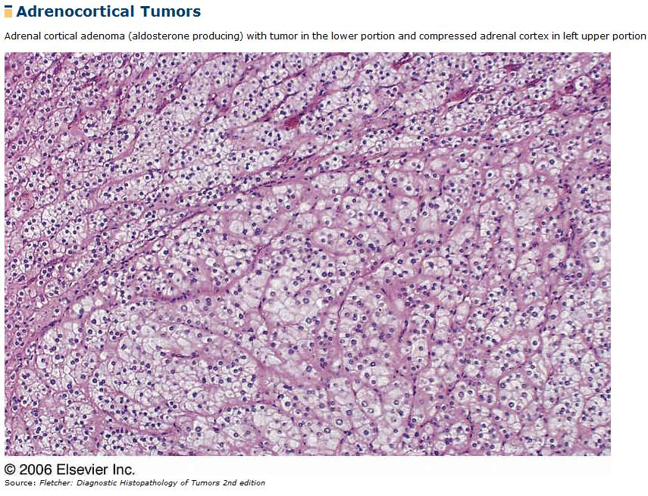
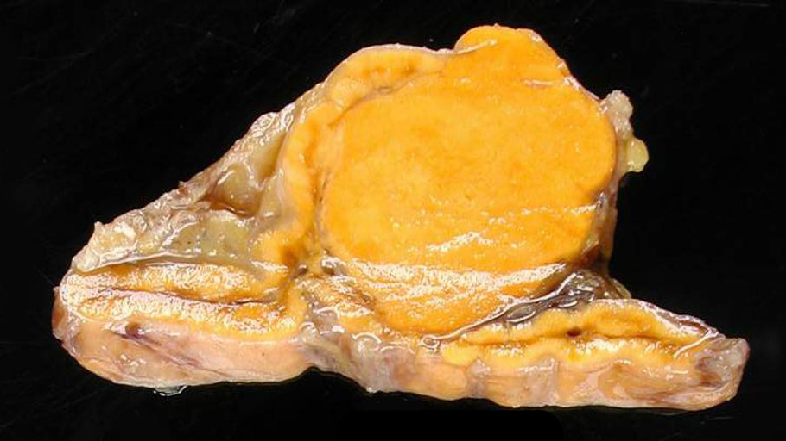
Normal
tumor
Conn Syndrome

Slide 37
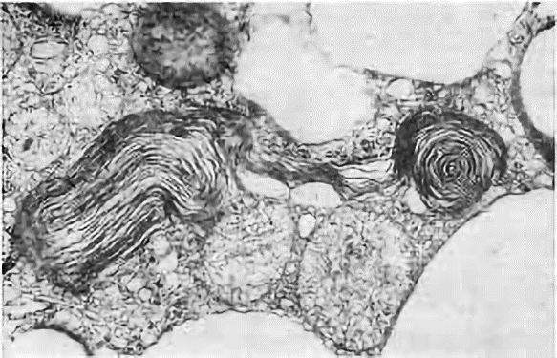
Spironolactone bodies
Spironolactone bodies:
Eosinophilic, lamellar, cytoplasmic inclusions found after spironolactone treatment
(upper left) Transmission electron microscopy shows membranes arranged concentrically around a central core with connection to endoplasmic reticulum and mitochondria
Spironolactone bodies

Slide 38
Questions?

Slide 39
Functional Adrenal Cortex Pathology (cont)
Hormone excess syndromes:
Glucocorticoid excess – Cushing syndrome
Mineralocorticoid excess – Hyperaldosteronism
Sex hormone excess – Adrenogenital syndrome
Hormone Deficiency Syndromes (next lecture):
Primary Adrenocortical Insufficiency
Secondary Adrenocortical Insufficiency

Slide 40
Causes of Adrenogenital syndrome (AGS)
Excess secretion of ACTH – ACTH also controls androgen formation in adrenal producing dehydroxyepiandrosterone (DHEA) and androstenedione, which are converted to testosterone peripherally
Adrenocortical neoplasms – More likely to be androgen-secreting adrenal carcinomas rather than adenomoas
Congenital adrenal hyperplasia (CAH) – a group of autosomal recessive disorders with different enzyme deficiencies involved in the production of cortical steroids.
Cortisol production decreased due to enzyme deficiency (ACTH increased due to lack of feedback inhibition)
Steroid substrates are shunted into other pathways resulting in increased production of androgens and virilization.
Sometimes the aldosterone pathway is impaired, leading to salt wasting
Notes:
CAUSES OF Adrenogenital syndrome
Excess secretion of ACTH
Adrenocortical neoplasms – More likely to be androgen-secreting adrenal carcinomas rather than adenomoas
congenital adrenal hyperplasia (CAH)

Slide 41
Congenital Adrenal Hyperplasia (CAH)
Congenital adrenal hyperplasia is characterized clinically by prenatal virilization and genital ambiguity in newborn girls, postnatal virilization in both boys and girls, and adrenal insufficiency (with or without salt wasting)
21-hydroxylase deficiency (CYP21A2 gene mutation, >90% of CAH)
90% of 21-hydroxylase deficiency is due to autosomal recessive recombination between functional gene CYP21A2 and a non-functional pseudogene CYP21A1
Patients are frequently compound heterozygotes for different types of mutations (i.e., one allele is less-severely affected than the other)
severity of disease expression is largely determined by the activity of the less-severely affected of the 2 alleles
Molecular genetic testing for common mutations of CYP21 gene is available and can diagnose disease up to 95% of affected individuals
Notes:
CAH → CLINICAL: virilization, precocious puberty, adrenal insufficiency – 90% cases due to 21-hydroxylase deficiency (5-8% due to 11-hydroxylase deficiency)
90% of 21-hydroxylase deficiency is due to autosomal recessive recombination between CYP21 and a pseudogene CYP21P
Different mutations and compound heterozygotes have variable severity of disease
Molecular genetic testing for common mutations of CYP21 gene is available and can diagnose disease up to 95% of affected individuals

Slide 42
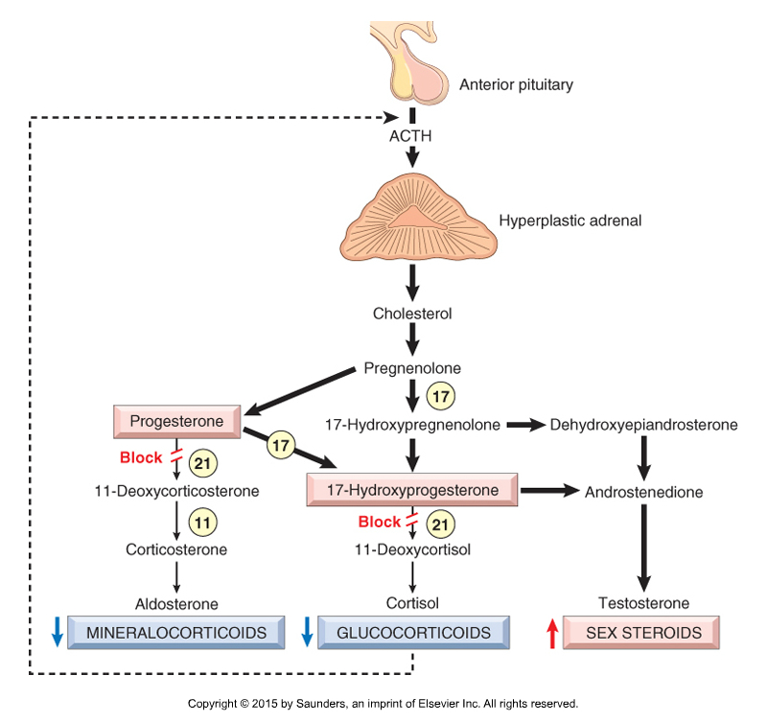
21-Hydroxylase deficiency impairs the synthesis of both cortisol and aldosterone.
The resultant decrease in feedback inhibition (dashed line) causes increased secretion of ACTH, resulting in congenital adrenal hyperplasia and increased synthesis of testosterone.
The sites of action of 11-, 17-, and 21-hydroxylase are shown by the numbers in circles
Notes:
21-Hydroxylase deficiency impairs the synthesis of both cortisol and aldosterone.
The resultant decrease in feedback inhibition (dashed line) causes increased secretion of ACTH, resulting in congenital adrenal hyperplasia and increased synthesis of testosterone.

Slide 43
Congenital adrenal hyperplasia and catecholamines
Congenital adrenal hyperplasia may also have a decrease in catecholamines contributing to cardiovascular collapse
Reasons for this catecholamine decrease include:
Decreased glucocorticoids also result in decreased synthesis of catecholamines
High levels of intra-adrenal glucocorticoids are required for synthesis of catecholamines
Notes:
Decreased glucocorticoids also result in decreased synthesis of catecholamines
High levels of intra-adrenal glucocorticoids are required for synthesis of catecholamines
Loss of catecholamine production may contribute to cardiovascular collapse

Slide 44
Syndromes of 21-hydroxylase deficiency
Salt-Wasting (classic) adrenogenitalism (70%)
Total lack of 21-hydroxylase resulting in no mineralocorticoids or glucocorticoids, and with shunting of excess substrates into androgen-producing pathways: 1:15,000-20,000 births
Clinical – salt wasting, hyponatremia, and hyperkalemia which induce acidosis, hypotension, cardiovascular collapse, and possible death
Simple virilizing adrenogenitalism (30%)
Decreased glucocorticoid causes increased ACTH secretion
No salt wasting (sufficient mineralocorticoid)
Androgen production is increased
Nonclassic (late-onset) adrenogenitalism:
Partial deficiency in 21-hydroxylase function; 1:500-1000 births (higher incidence in Hispanics and Ashkenazi Jews)
Later onset (cannot be diagnosed with routine newborn screening)
Females may be asymptomatic or present with hirsutism, acne, menstrual irregularities
Males may present with precocious puberty or oligospermia in older males
Notes:
3 types:
Salt-Wasting (classic) adrenogenitalism (70%)
Total lack of 21-hydroxylase resulting in no mineralocorticoids or glucocorticoids, and with shunting of excess substrates into androgen-producing pathways
Clinical – salt wasting, hyponatremia, and hyperkalemia which induce acidosis, hypotension, cardiovascular collapse, and possible death
Simple virilizing adrenogenitalism (30%)
Decreased glucocorticoid causes increased ACTH secretion
No salt wasting (sufficient mineralocorticoid)
Androgen production is increased
Nonclassic adrenogenitalism:
Partial deficiency in 21-hydroxylase function; 1 in 1000 births (higher incidence in Hispanics and Ashkenazi Jews)

Slide 45
Salt-wasting syndrome or classic AGS
Total lack of 21-hydroxylase resulting in no mineralocorticoid and no glucocorticoids with substrates channeled into androgen producing pathways
Apparent at birth or shortly thereafter (in utero, electrolyte balance can be maintained maternally)
At birth, females can be suspected immediately to have this syndrome due to virilization
Males will come to attention in 5 to 15 days with salt-losing crisis
A subset of patients with classic androgenitalism may have adrenomedullary dysplasia, a developmental defect of medulla causing decreased catecholamine secretion
Notes:
Salt-wasting syndrome or classic adrenogenitalism
Apparent at birth or shortly thereafter (in utero, electrolyte balance can be maintained maternally)
At birth, females can be suspected immediately to have this syndrome due to virilization
Males will come to attention in 5 to 15 days with salt-losing crisis
May have adrenomedullary dysplasia, a developmental defect of medulla causing decreased catecholamine secretion

Slide 46
Simple virilizing AGS
No salt wasting (sufficient mineralocorticoid)
Decreased glucocorticoid causes increased ACTH secretion → Androgen production is increased
Presents as ambiguous genitalia
Progressive virilization
Notes:
Decreased glucocorticoid causes increased ACTH secretion → Androgen production is increased
No salt wasting (sufficient mineralocorticoid – not affected by increased ACTH)

Slide 47
Nonclassic or late-onset AGS
Partial deficiency in 21-hydroxylase function
cannot be diagnosed with routine newborn screening
Women with NCAGS are generally born with normal female genitalia. Later in life, signs and symptoms of the condition can vary but may include hirsutism, frontal baldness, delayed menarche (first period), menstrual irregularities, and infertility.
Males with NCAGS may have early beard growth and relatively small testes. Typically, they have normal sperm counts.
Late-onset AGS is caused by combined heterozygosity of a "mild" and a "severe mutation" (or two "mild mutations“) in the 21-hydroxylase gene CYP21A2 (>90%) or 21-beta-hydroxylase gene CYP11B1 (5-8%).
Notes:
Nonclassic or late-onset AGS
Partial deficiency in 21-hydroxylase function
cannot be diagnosed with routine newborn screening
Late-onset AGS is caused by combined heterozygosity of a "mild" and a "severe mutation" (or two "mild mutations“) in the 21-hydroxylase gene CYP21A2 (>90%) or 21-beta-hydroxylase gene CYP11B1 (5-8%).

Slide 48
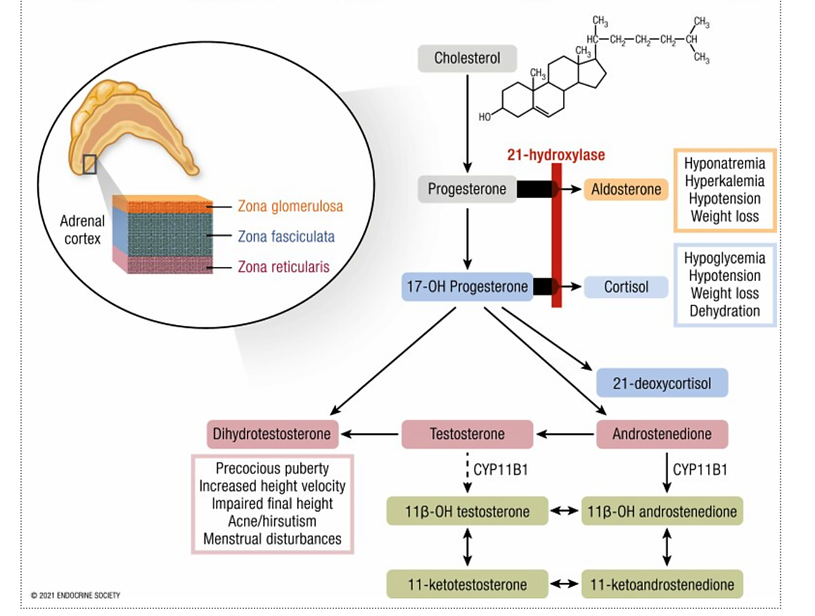
Congenital Adrenal Hyperplasia
H&P - The symptoms of congenital adrenal hyperplasia include:
Mineralocorticoid Inadequacy
Vomiting because of salt-wasting leads to dehydration, hypovolemia, shock, and death.
Excess Androgens
Males: excessive facial hair, functional and average-sized penis with extreme virilization but no sperm
Females: ambiguous genitalia, menstrual irregularity, infertility because of anovulation, enlarged clitoris, and shallow vagina
Early pubic hair and rapid growth in childhood
Precocious puberty or failure of puberty to occur
Laboratory Studies - In classic 21-hydroxylase deficiency, laboratory tests will show:
Hypoglycemia (because of hypocortisolism)
Hyponatremia (because of hypoaldosteronism)
Hyperkalemia (because of hypoaldosteronism)
Elevated 17alpha-hydroxyprogesterone

Slide 49
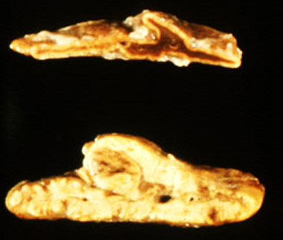
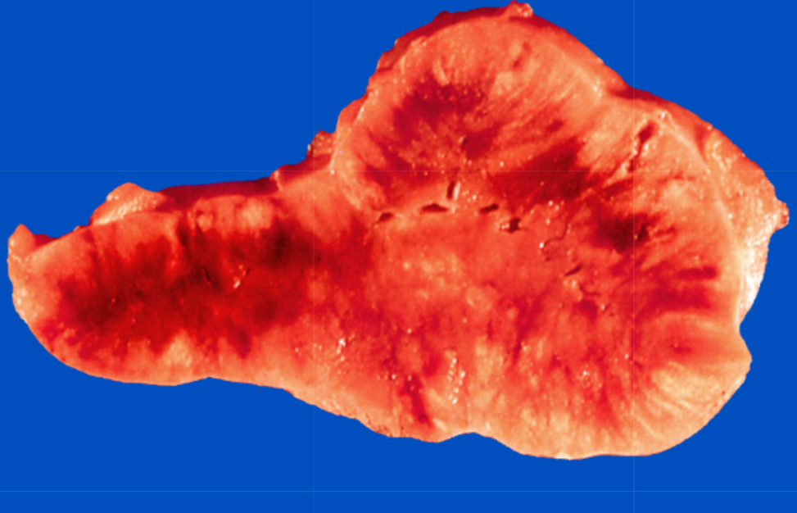
Morphology in Congenital Adrenal Hyperplasia
Pituitary
Hyperplasia of ACTH producing cells
Occurs due to low cortisol resulting in lack of negative feedback with elevation of hypothalamic CRH causing increased ACTH production and corticotroph hyperplasia
Adrenal
Gross
Bilaterally hyperplastic cortex, 10 to 15 times normal weight due to SUSTAINED ELEVATION OF ACTH from lack of cortisol (no feedback inhibition)
Thickened nodular cortex which on cut section is brown due depletion of lipid
Histology
Eosinophilic, lipid-depleted cells admixed with lipid-laden cells
ACTH-dependent hyperplasia usually shows diffusely thickened cortex with streaks and patches of yellow lipid-containing cells and brown lipid-depleted cells.
Notes:
Diffuse hyperplasia – ACTH-dependent Cushing syndrome
Gross – Both glands enlarged, weighing up to 30 grams with diffusely thickened and variably nodular cortex – brown areas show depletion of lipid
Microscopic – Expanded “lipid-poor” zona reticularis with compact, eosinophilic cells, surrounded by an outer zone of vacuolated “lipid-rich” cells (any nodules are “lipid-rich”)

Slide 50
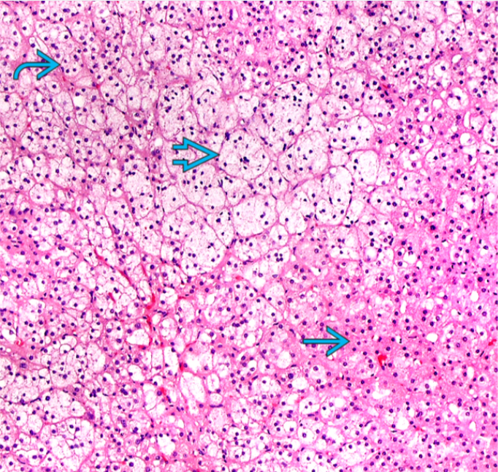
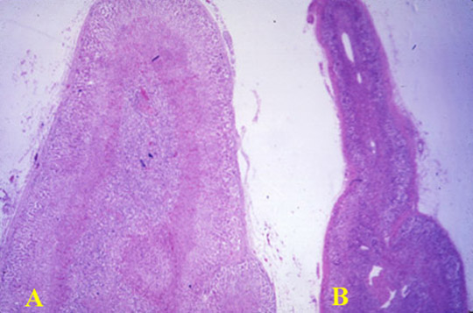
Mild to moderate ACTH-dependent cortical hyperplasia shows enlarged lipid-containing cells, compact lipid-depleted cells, and lipid-containing cells resembling normal zona fasciculata.
https://www.meddean.luc.edu
Cut section compares the thickness of the cortices of a hyperplastic adrenal gland (A) and a normal gland (B).
https://memorang.com/flashcards/230160/4+Adrenal+Pathology

Slide 51
Questions?
Dr. Ahsanuddin’s Office Hours:
12-2pm Tuesday and Wednesday
Email: arshad.ahsanuddin@lmunet.edu
Office: DCOM-Knoxville, Room 216 Office Phone: 865-338-5739
Please email, drop by, or call to set up a Zoom conference if you have any questions outside of lecture.

